Slide 1

RUNGTA COLLEGE OF DENTAL SCIENCES & RESEARCH
ORAL CAVITY
DEPARTMENT OF GENERAL MEDICINE

Slide 2
Specific learning Objectives
At the end of this presentation the learner is expected to know ;
Core areas* | Domain ** | Category #
DISEASE OF MOUTH | COGNITIVE | MUST KNOW
DISEASE OF LIPS | COGNITIVE | MUST KNOW
DISEASE OF TONGUE | COGNITIVE | MUST KNOW
DISEASE OF PALATE | COGNITIVE | MUST KNOW
DISEASE OF TONSILS | COGNITIVE | MUST KNOW
DISEASE OF SALIVARY GLAND | COGNITIVE | MUST KNOW

Slide 3
Table of Content
DISEASE OF MOUTH
DISEASE OF LIPS
DISEASE OF TONGUE
DISEASE OF PALATE
DISEASE OF TONSILS
DISEASE OF SALIVARY GLAND

Slide 4
DISEASES OF ORAL CAVITY

Slide 5
1. Premalignant conditions of oral cancers.
2. TNM classification of oral cancers.
3. Carcinoma cheek.
4. Carcinoma tongue.
5. Carcinoma lip.
6. Carcinoma maxillary antrum.
7. D/D of ulcers of tongue.
8. Odontomes.
9. Epulis.
10. Vincent angina.
11. Median mental sinus.
12. Cleft lip and cleft palate

Slide 6
PRE MALIGNANT CONDITIONS FOR ORAL CANCERS
1.Leukoplakia
2.Erythroplakia
3.Submucus fibrosis
4.Papilloma of tongue/cheek
5.Chronic hyperplastic candidiasis
6.Syphilytic glossitis
7.Discoid lupus erythematosis
8.Dyskeratosis congenita

Slide 7
LEUKOPLAKIA
Leukoplakia is a white patch over the mucosa of
Oral cavity which can’t be scrapped and can’t be
associated with any disease.It is a pre malignant
condition.
CAUSES-
1.Smoking
2.Spices
3.Spirits
4.Sharp tooth,poor oral hygiene
5.Sunlight-actinic rays
6.Syphilis
7.Susceptibility of a person.

Slide 8
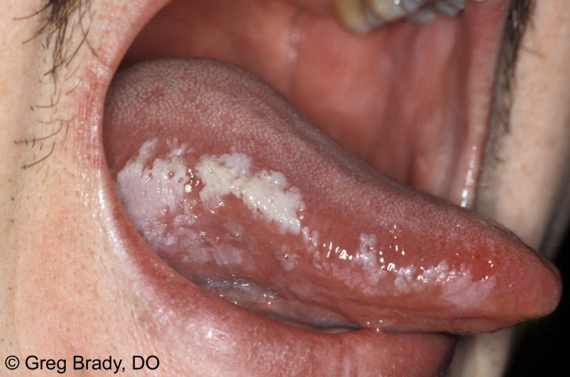
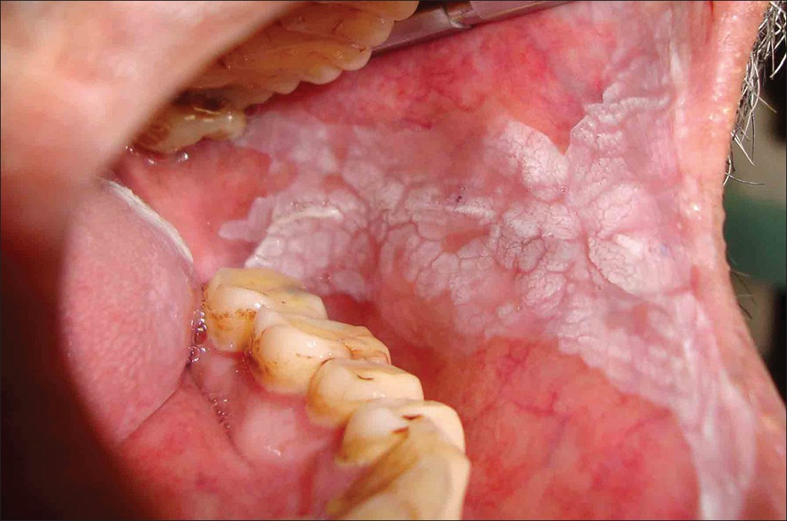

Slide 9
Histological grading of leukoplakia-
Acanthosis
Parakeratosis
Widening of retepegs
Dyskeratosis
Dysplasia
Carcinoma in situ
Incidence- of leukoplakia is 20% in smokers.
Where as it is 1% in non smokers.
Incidence of leukoplakia turning into malignancy is
2-10%.It increases with age and duration.
Treatment-
1.Stop smoking etc.
2.Excision of lesion with (some time) skin grafting is done.
3.Isoretinoin can reverse some cases of leukoplakia.
***

Slide 10
ERYTHROPLAKIA
Erythroplakia is defined as a fiery red patch that cannot be characterized either clinically or pathologically as any other definable lesion .These may appear as smooth, velvety, granular or nodular lesions often with a well-defined margins adjacent to normal looking mucosa.The soft palate, the floor of mouth, the cheek are common site.
INCIDENCE-Chances of malignancy is 10-15%.

Slide 11
Treatment. Treatment involves biopsy of the lesion to identify extent of dysplasia. Complete excision of the lesion is sometimes advised depending on the histopathology found in the biopsy. Even in these cases, recurrence of the erythroplakia is common and, thus, long-term monitoring is needed

Slide 12
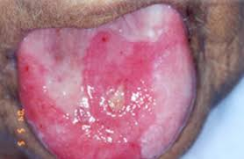
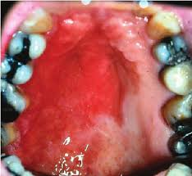
ERYTHROPLAKIA

Slide 13
SUBMUCUS FIBROSIS

Slide 14
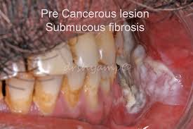
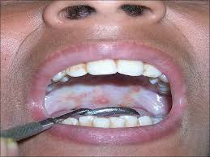
SUBMUCUS FIBROSIS

Slide 15
*Mostly due to hypersensitivity reaction to chillies,cakphor,tobacco or due to vitamin deficiencies.
*Usually it start as ulceration on the mucosa of cheek which heals by fibrosis.It appears as firm to hard.Tongue may also be affected.
*Chances of malignancy is 10-15%
TREATMENT-It is treated by excision and followed by reconstruction.
****

Slide 16
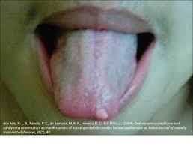
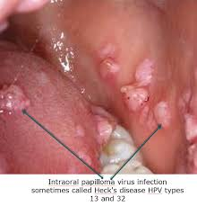
PAPILLOMA OF CHEEK OR TONGUE

Slide 17
Oral Human Papilloma Virus (HPV) Infection. Human papilloma virus (HPV), commonly known as the virus that causes genital warts and cervical cancer in women, is increasingly being recognized as a cause of infections that colonize the back of the mouth (throat), including the tongue base and tonsils.
Treatment-Fulguration with diathermy can be done.

Slide 18
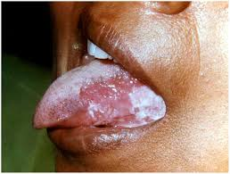
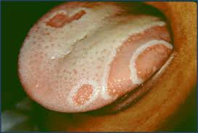
CHRONIC HYPERPLASTIC CANDIDIASIS

Slide 19
Chronic hyperplastic candidiasis (CHC), earlier known as candidal leukoplakia, is a variant of oral candidiasis that classically presents as a white patch on the commissures of the oral mucosa and it is mostly caused by Candida albicans. Clinically, the lesions are usually asymptomatic and regress after appropriate
antifungal treatment.

Slide 20
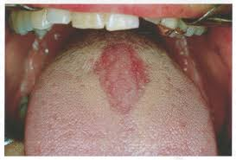
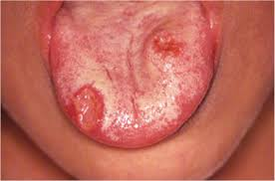
SYPHILITIC GLOSSITIS

Slide 21
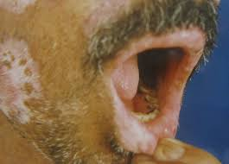
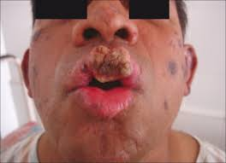
DISCOID LUPUS ERYTHEMATOSIS

Slide 22
Discoid lupus erythematosus (DLE) is the most common form of chronic cutaneous lupus erythematosus. Classic DLE lesions begin as red-purple macules, papules or small plaques and rapidly develop a hyperkeratotic surface. Most patients with untreated classic DLE lesions suffer indolent progression towards malignancy.

Slide 23
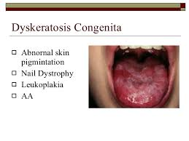
DYSKERATOSIS CONGENITA

Slide 24
Dyskeratosis congenita (DKC) is an inherited disorder. Symptoms include abnormal skin pigmentation, abnormal nail growth, and leukoplakia (white patches inside the mouth). Patients with DKC are predisposed to bone marrow failure, some cancers, and pulmonary problems.

Slide 25
TNM CLASSIFICATION OF ORAL TUMOURS
Primary tumour (T)
To : no evidence of tumour.
Tis :Carcinoma in situ
T1 : less than 2cm
T2 :Between 2-4 cm
T3 :More than 4 cm
T4 :Any cancer invading nearby structures.

Slide 26
Cervical Lymph Nodes (N)
Nx :Nodes can’t be assessed
No :No lymph node metastasis
N1 :Single,ipsilateral node,size-less than 3cm.
N2a: Single,ipsilateral node,sizeless than 6cm
N2b:Multiple ipsilateral nodes but all less
than 6 cm size.
N2c:Bilateral multiple nodes but all less than
6 cm size.
N3 : Lymph nodes more than 6 cm size.
Distant metastasis (M)
Mo: No distant metastasis.
M1: Distant metastasis present.

Slide 27
CARCINOMA OF CHEEK
The most common cancer of the cheek is
- SQUAMOUS CELL CARCINOMA.
-Adenocarcinoma from minor salivary glands.
- Melanoma from pigment cell may occur.
(Both are very rare).
Precipitating factors are-
All-’S’-Smoking,
-Spirit
-Syphilis
-Sharp tooth
-Sepsis
-Spices

Slide 28
Premalignant condition
1.Leukoplakia
2.Erythroplakia
3.Submucosal fibrosis
4.Hyperplastic candidiasis.
(Betel nut chewing is an important cause)
Pathological types-
Ulcerative-a non healing ulcer
Proliferative-Cauliflower or verrucous carcinoma
Infiltrative lesion-slowly involve the nearby
tissue(tongue,mandible or floor of mouth,skin)

Slide 29
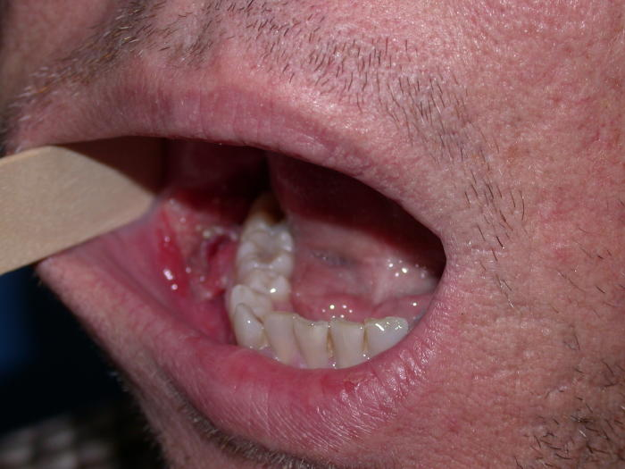

Slide 30
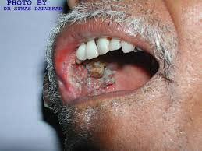
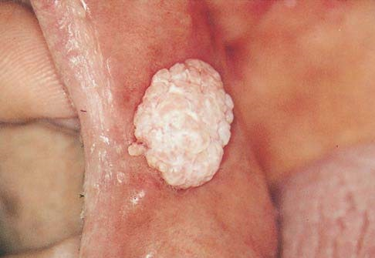

Slide 31
Biological behavior of Ca.cheek
1.More common in posterior half.
2.It spread to deeper plane to involve muscles.
3.It spreads outwards to involve the skin causing
fungation,ulceration and formation of oro-cut
-eneous fistula.
4.Mandible is commonly involved directly or
indirectly thr. Lymphatics.
5.Commonly involved L.nodes are-submental,
submandibular and deep cervical.
6.Infection is common around tumour causing-fever
foul smelling ulcer and halitosis.
7.Respiratory infection is common in patient.
8.Dysphagia occur when tumour extend to pharynx,soft palate or
retromolar region.

Slide 32
Clinical features-
A non healing ulcer in cheek or cauliflower like growth or exophytic.
Bleeds on touch.
Halitosis
Pain-when skin or bone involved and infection
Everted edges and induration are characteristic of such ulcer.
Trismus and dysphagia signifies extension of
tumour.
Lymph nodes are hard,nodular,initially mobile but later fixed.
Submandibular and deep cervical L.glands +ve
It may involve hypoglossal and accessory spinal nerve
and cervical sympathetic chain.
Compression of external carotid artery,later fungation there, may
cause bleeding from major vessels—Carotid blow out.

Slide 33
Spread of tumour-
1.Local spread-To nearby tissues like skin,mandible or tongue etc.
2.Lymphatic spread- level 1 & 2 groups of lymph-nodes enlarges.In 50% cases the enlargement is due to infection and remaining 50% it is due to metastasis.
3.Blood spread is rare and late.

Slide 34
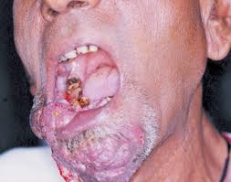
Infiltrative type

Slide 35
Investigation-
1.Edge biopsy taken from the edge of tumour.
2.FNAC of involved Lymph node
3 CT scan to see extent of disease.
4.Orthopentamogram-to see mandible involve?
5. X-ray chest to rule out pneumonia

Slide 36
Treatment
FOR EARLY CASES-(T1,T2)-
Both surgery and RT can be used
SURGERY-
1.A small ulcer (T1T2) is treated by wide excision
followed by split skin graft.
2.Small infiltrative ulcer is treated by wide excision followed by flap reconstruction.
--In male-fore head flap
--In female deltopectoral flap were used.
Now a days-both above flaps are not in practice ,instead
PMMC (pectoralis major myo-cuteneous )flap
is used.

Slide 37
RADIOTHERAPY-
Early lesions can be managed with Radiotherapy
Indication-
1.Pt. not willing for operation.
2.Pt. not fit for operation.
3.T1 & T2 lesion.
4.Lesion near the commisure.
Type-
1.External radiotherapy-total dose of
6000 -8000 cGy units are given.
2.Interstitial radiotherapy-It is indicated in
infiltrative small lesion.Caesium-137 or
Iridium wires are placed within the tumour.

Slide 38
ADVANCED CARCINOMA CHEEK
In T3 &T4 cases surgery is done followed by radiotherapy.
Most of the cases requires wide excision,leaving
large gap on the surface,which requires reconstructive surgery.For this, PMMC flap are used.
PMMC flap-Most widely used flap for head and neck surgery.The flap is raised along with muscle and skin with pectoral branch of thoraco-acromial
artery.It is tunneled under the skin of chest wall and neck and brought to the area of defect.It is called
WORK HORSE for head & neck reconstruction .
Surgery may include-Wide excision
-Partial or hemimandibulectomy
-Neck lymph node block dissection
Radiotherapy-May be curative or palliative.
-Then it may be External or Brachytherapy.
Chemotherapy-Intra-arterial ,IV , Oral. (METHOTREXATE,ADRIAMYCIN,VINCRISTINE,BLEOMYCIN)
Block dissection of neck-

Slide 39
PROGNOSIS
The 5-year relative survival rates for cancers of
the oral cavity and pharynx (throat) are: 83% for cancer that has not spread.
62% for cancer that has spread to nearby lymph nodes.
38% for cancer that has spread to distant parts of the body.

Slide 40
TONGUE

Slide 41
Anatomy of Tongue
Development-
*The anterior 2/3 tongue develops from 1st bronchial arch.(Lingual nerve).
*The posterior 1/3 develop from 3rd bronchial arch(glassopharyngeal nerve)
* and the most posterior part develop from 4th arch which is supplied by
vagus nerve.
Lymphatic drainage of tongue-
1.Apical vessels---to submental group
2.Central vessels- toSubmandibular glands
3.Marginal vessels-to upper deep cervical
4.Basal vessels------to pharyngeal group
Lymphatics in the midline of tonue freely cross communicate with each other and so,spread of malignancy may involve lymph-nodes of both sides.

Slide 42
Blood supply-
The tongue receives its blood supply primarily from the lingual artery, a branch of the external carotid artery. The lingual veins, drain into the internal jugular vein. The floor of the mouth also receives its blood supply from the lingual artery.[ There is also a secondary blood supply to the tongue from the tonsillar branch of the facial artery and the ascending pharyngeal artery.

Slide 43
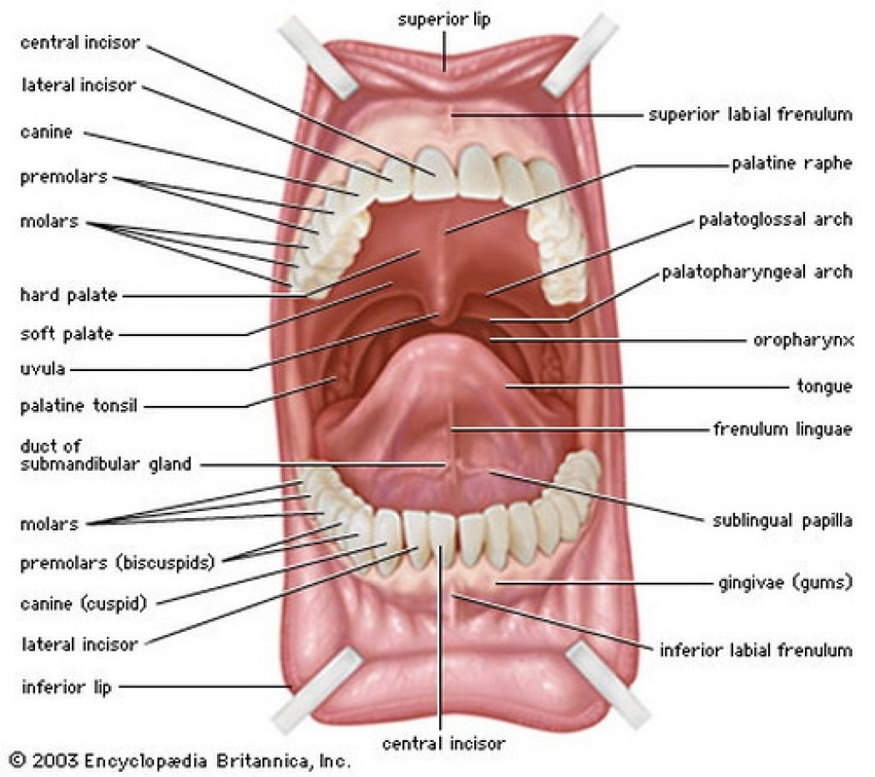

Slide 44
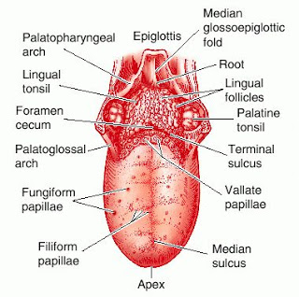

Slide 45
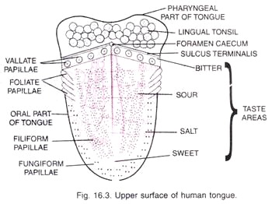

Slide 46
CARCINOMA OF TONGUE

Slide 47
Incidence-
Equal in both sexes.
Etiology-
*Leukoplakia
*Erythroplakia
*All’s’
*Premalignant conditions

Slide 48
Types -Morphologically-
-Papillary
-Ulcerative-proliferative
-Fissure with induration
-Lobulated indurated mass.
Histologically-Squamous cell carcinoma(common)
-Adenocarcinoma from minor salivary
gland or mucus glands.
-Melanomas.
Sites– Lateral margin (commonest-47-50%)
Posterior third- 20%
Dorsum---------6.5%
Ventral surface—9%

Slide 49
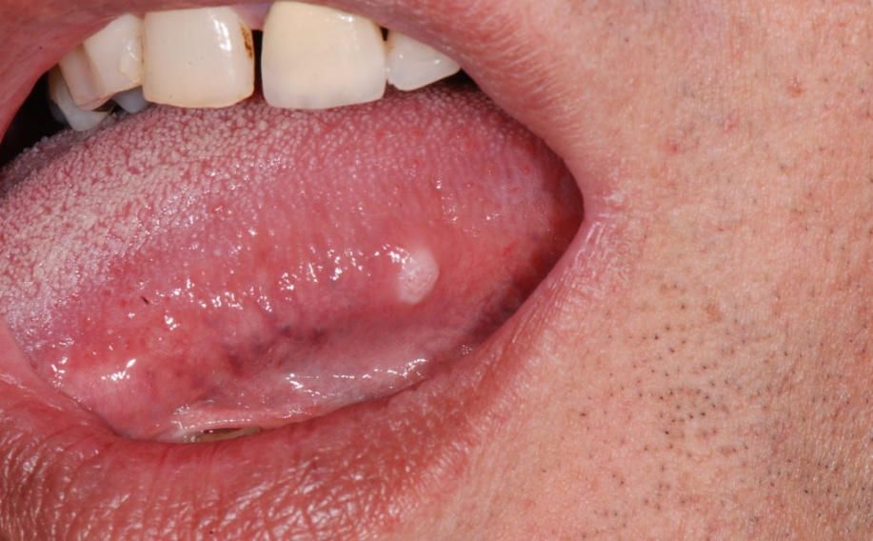
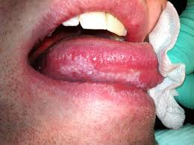
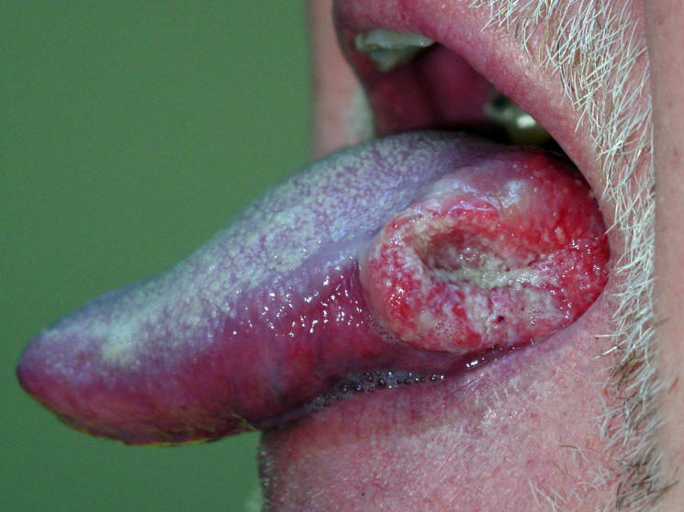

Slide 50
Presenting features-
Excessive salivation
Bleeding ulcer
Pain over tongue
Change in voice
Ankyloglossia
Dysarticulation
Dysphagia
Foetor oris
Bilateral massive enlargement of lymph glands.

Slide 51
Local spread-
*Ant.2/3 spread to muscles,floor of mouth &
mandible.
*Posterior1/3 spread to tonsil,pharynx,soft
palate,epiglottis and larynx.
Lymphatic spread-
It may spread to all lymph
node from level 1 to 4.
Blood spread –
- It is not common compare to
local & lymphatic spread.

Slide 52
Investigation-
1.Edge biopsy
2.FNAC of L.node
3.Indirect and direct laryngoscopy to
see posterior 1/3 of tongue.
4.CT scan to see extent of growth.
5.Chest X-ray to see bronchopneumonia.
6.All other routine examinations.

Slide 53
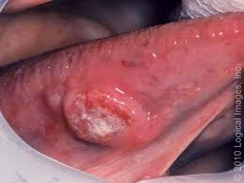
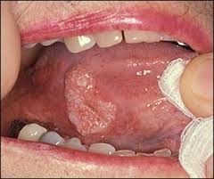

Slide 54
Treatment
Surgery------Radiotherapy-----Chemotherapy
SURGERY-(Various types of surgery)
1.Wide excision with 1cm.margin &1cm depth as
done in case of carcinoma in situ or very small
tumour.
2.Partial glossectomy-when lesion is less than 2cm and limited to lateral border of tongue.About 1/3 of anterior 2/3 of tongue is removed.This should include atleast 2cm of tissue away from the tumour.(Alternatively Radiotherapy can also be given)
3.Hemiglossectomy-This refers to 50% removal of the tongue.This is indicated in radio-residual,radio-recurrent or where radiotherapy is not available.

Slide 55
4.Total glossectomy-Indications are same as above.In case tumour involving whole tongue ,initially radiotherapy is given followed by total glossectomy.
This operation carries high incidence of mortality and morbidity.
5.Commando’s operation-indicated when carcinoma of tongue is fixed to the mandible with infiltration of floor of the mouth.
The operation includes-
Hemi-glossectomy
Hemi-mandibulectomy
Removal of the floor of the mouth
& Radical neck dissection.

Slide 56
TREATMENT OF METASTATIC LYMPH-NODE IN NECK
These can be managed by both surgery as well by radiotherapy.
Radiotherapy can be given in all stages of secondaries in neck but main indication is large primary with neck nodes.
*If the general condition of the patient is good,with lymphnode hard & mobile-commando’s operation can be done.
*if RND has to be done on both side,The IJV should be preserved atleast on one side.
Alternatively,radiotherapy is another choice.

Slide 57
Radiation Therapy
Radiation therapy, including intensity modulated radiation therapy, stops cancer cells from dividing and slows the growth of the tumor. Radiotherapy also destroys cancer cells and can shrink or eliminate tumors. Intensity modulated radiation therapy allows the use of more effective radiation doses with fewer side effects than conventional radiotherapy techniques.
Radiation therapy involves 5-6 weeks of daily treatments.
Radiotherapy can be given in all stages of secondaries in neck but its main indication is a large primary tumour with neck nodes.

Slide 58
Chemotherapy
Chemotherapy is prescribed for different reasons:
Together with radiotherapy as an alternative to surgery (called chemo- radiation)
After surgery to decrease the risk of the cancer returning
To slow the growth of a tumor and control symptoms when the cancer cannot be cured (palliative treatment)

Slide 59
CAUSE OF DEATH
1.RECURRENT ASPIRATIONAL PNEUMONIA
2.Gross local recurrence ,fungation ,ulceration &
cachexia.
3.Uncontrolled hemorrhage from growth.
*********

Slide 60
CARCINOMA OF LIP

Slide 61
CARCINOMA OF LIP
Incidence is 10-12%
Common in men 90%
Common in lower lip 90%
Causes-
1.Ultraviolet rays
2.Smoking
3.Agriculturist who are exposed to Sun rays
hence it is also called COUNTRYMEN’S LIP
4.Khaini chewers(mixture of tobacco+lime)
Histology-commonly it is a well differentiated squmous cell carcinoma

Slide 62
Clinical features-
1.Non healing painless progressive ulcer
2.Everted edge with induration
3.Growth moves with lip.
4.Submental,submandibular or deep cervical
nodes may be palpable.
5.Fungation, bleeding may be seen.

Slide 63
D/D-
1.Keratoacanthoma(cuteneous tumour arising from hair follicle on lip)
2.Basal cell carcinoma
3.Minor salivary gland tumour
4.Extension of Ca.cheek on lip.
Diagnosis-
1.Edge biopsy
2.FNAC of node

Slide 64
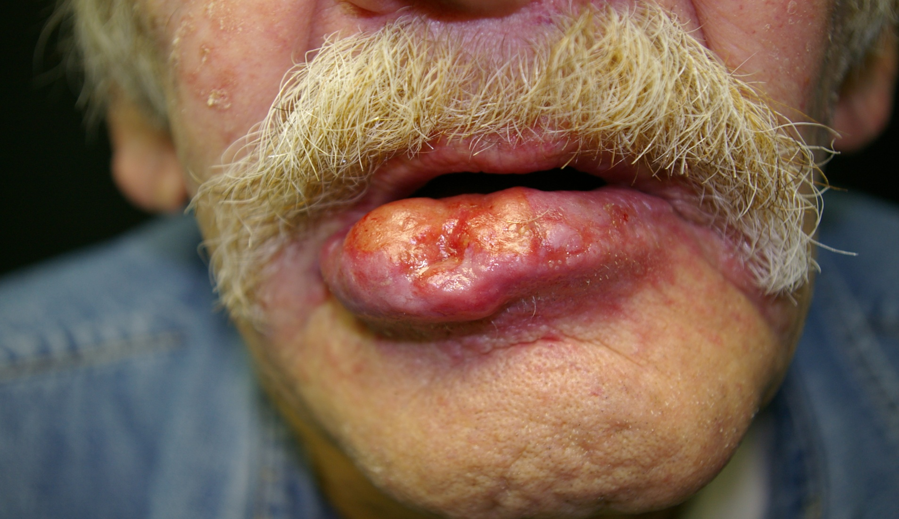

Slide 65
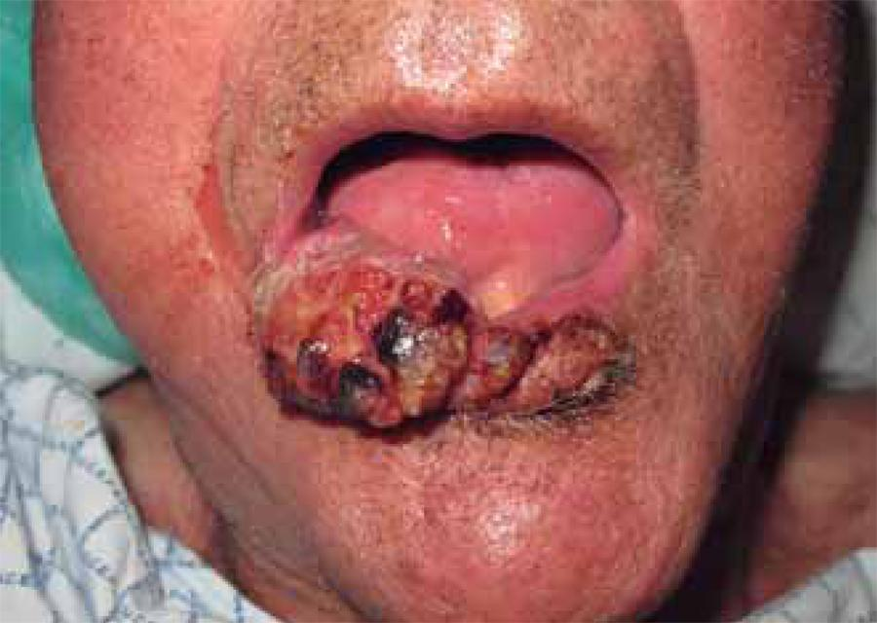

Slide 66
TREATMENT-
T1 & T2 lesions can be excised followed by direct suturing.this is described as ‘V” excision which include removal of growth with 1cm healthy margin.Full thickness of lip is to be removed.
If lesion is less than 2cm, then alternatively curative
radiotherapy can be given. Dose-6000 cGy.
If tumour is more than 2 cm,wide excision is done.Excision of 1/3 of lip does not require, reconstruction surgery but excision of more than 1/3 lip requires reconstructive surgery.

Slide 67
Larger tumours T3 & T4 are irradiated first ,followed by excision of entire lip and reconstruction of lip by PMMC flap.
Lymph nodes are dealt with RND on one side and functional block dissection other side.
Post-operative radiotherapy is given if tumour is large or if lymph nodes are involved.
PROGNOSIS-
GOOD -5YRS SURVIVAL RATE IS 70%.
***********

Slide 68
Carcinoma Maxillary Antrum
It is common in workers engaged in furniture industries,chromic and nickel industries.
Clinical presentation-
Bulge in hard palate.
Nasal obstruction and epiphora.
Asymmetry of face
Proptosis and diplopia
Trismus and paraesthesia over cheek,lip,gums.

Slide 69
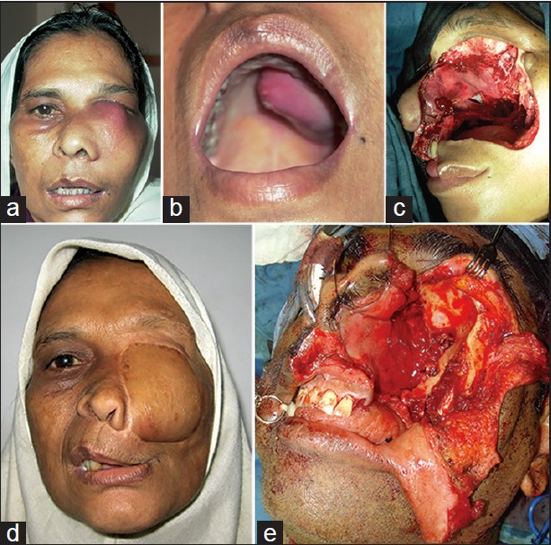

Slide 70
Investigations-
1.CT scan.
2.Sinoscopy
Treatment-
*Radiotherapy is the main method of treatment.
*Partial maxillectomy for lower half tumours
and total maxillectomy for tumours involving
whole antrum can be done.
*Indications and contra-indication for surgery and radiothepy are same as other oral cancer.

Slide 71
D/D OF ULCERS OF THE TONGUE
Painful ulcers of the tongue
1.Aphthous ulcer-
Small, multiple,very painful minor or major ulcer.
They subside in few days.Vit-B orally and salicylate gel are given to get relief.
2.Dental ulcers-
These are due broken tooth,sharp tooth,ill fitting denture.These are traumatic ulcer,mostly on lateral edge.
3.Tubercular ulcers-
Mostly seen on tip of the tongue,very painful.Neck glands+ve and its edges are undermined.May be multiple with serous discharge.

Slide 72
Painless ulcers of the tongue-
1.Carcinomatous ulcers-
On lateral margin,non healing painless.Bleeds on touch.Edges are everted,Base is indurated.Hard fixed neck glands may be seen.
2.Gummatous ulcers-
History of syphilis,punched out edges are peculiar.
3.Systemic diseases ulcers-
Pemphigus, SLE, Lichen planus and post
pertussis ulcer are seen.
.

Slide 73
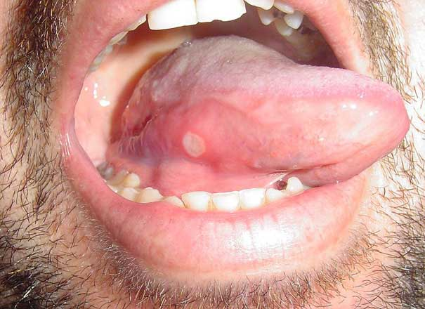

Slide 74
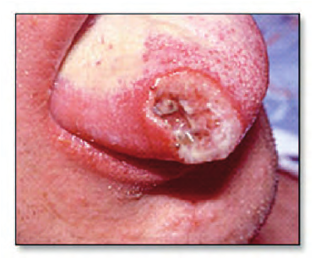
Tubercular ulcer

Slide 75
JAW TUMOURS

Slide 76
JAW TUMOURS
Classification of Jaw Tumours
1.Swelling arising from the gum
Congenital epulis.
Fibrous epulis.
Pregnancy epulis.
Giant cell epulis.
Myelomatous epulis.
Sarcomatous epulis.
2.Swelling arising from dental epithelium/mesothelium-(odontomes)
Ameloblastoma (Admentinoma)
Enemeloma/cementoma/dentinoma
Odontogenic fibroma/myxoma
CYST arising in relation to dental epithelium- Dental cyst
-Dentigerous cyst.
3.Swelling arising from Maxilla/Mandible-
Osteoma & osteoblastoma
Osteosarcoma/osteoclastoma
Secondaries from other primary
4.Surface tumours-
Tumours from surface which extend to jaw(ossifying fibroma,ivory osteoma etc.)

Slide 77
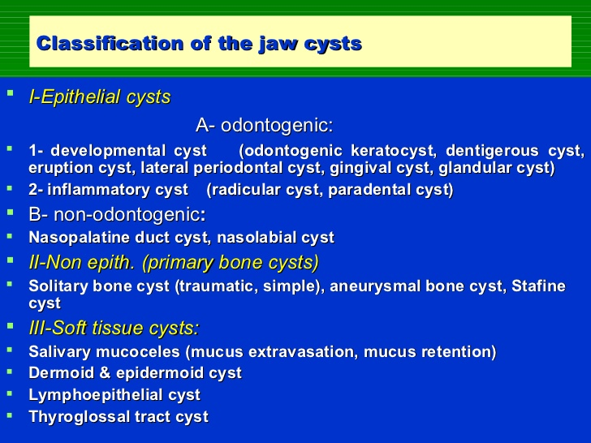

Slide 78
EPULIS
Definition- It is a swelling arising from the
muco-periosteum of gum.
1.Congenital epulis-Common in girls and in upper jaw.Not a malignant.Bleeds on touch.
Treatment-Excision
2.Fibrous epulis-Any person with carries tooth.Seen adjacent to carries tooth.Commonest variety.It is fibroma arising from the periodontal membrane.
D/D-Squemous cell carcinoma of gum
Investigation- X-ray
-OPG
-Biopsy from the lesion
Treatment-Excision with extraction of the adjacent tooth.
3.Pregnancy epulis-Due to inflammatory gingivitis usually during 3rd month of pregnancy.
Usually dissolve after pregnancy otherwise excision is done.

Slide 79
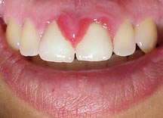
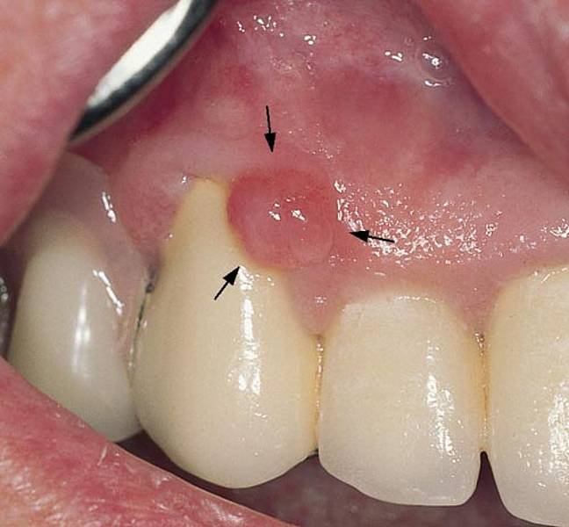

Slide 80
4.Myelomatous epulis-
It is seen in leukemia patient .
Treatment- Treat for leukemia
5.Granulomatous-
It is seen as mass of granulomatous tissue
near the carries tooth.
6.Giant cell epulis-
In osteoclastoma causes ulceration &
bleeding.
7.Carcinomatous-Squamous cell carcinoma of the alveolus & gum presenting as hard,localized indurated swelling with ulceration.
8.Fibrosarcomatous epulis-arising from fibrous tissue gum.

Slide 81
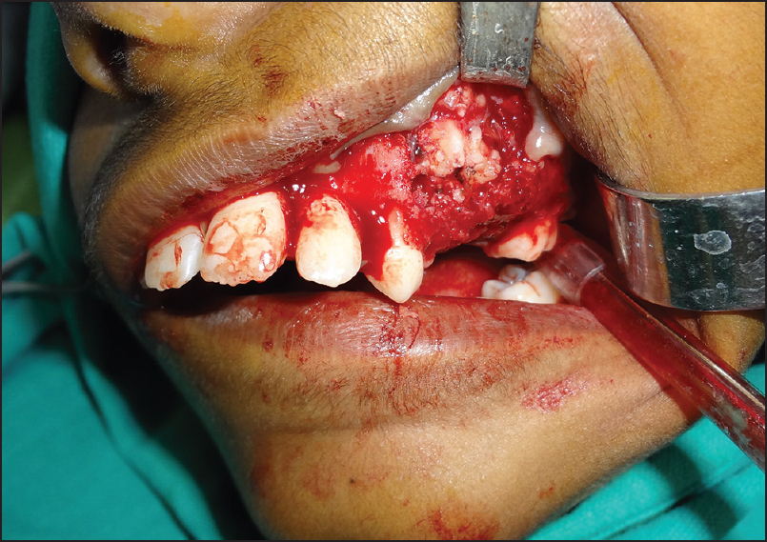

Slide 82
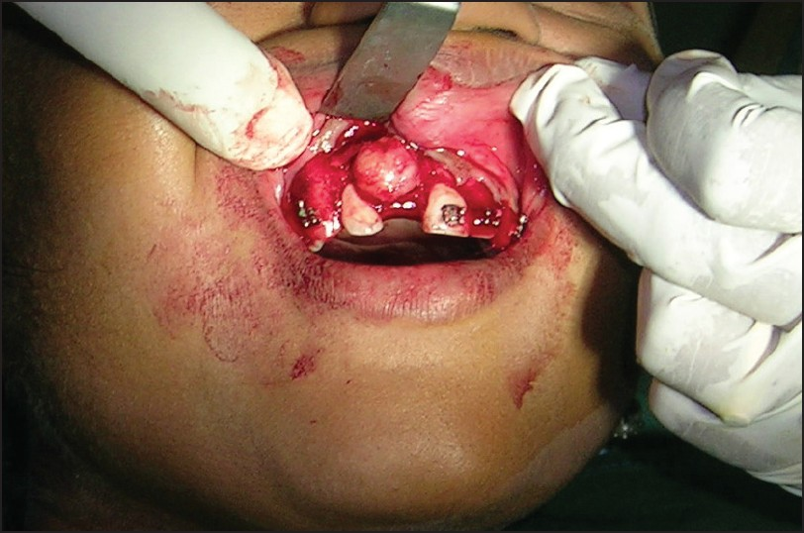

Slide 83
ODONTOMES
Definition-
An odontome is a benign tumor of
cells of dental tissue. (i.e. linked to
tooth development ).
Specifically, it is a dental hamartoma, meaning that it is composed of normal dental tissue that has grown in an irregular way.

Slide 84
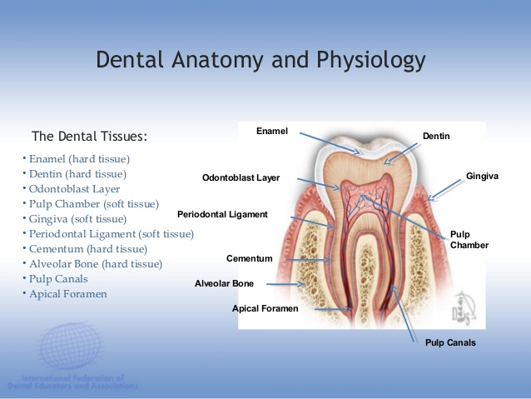

Slide 85
The important and common
dental tumor like swelling
*Admantinoma
* Dental cyst
*Dentigerous cyst.

Slide 86
Admantinoma
(Eve’s disease, multilocular cystic disease of jaw)

Slide 87
This tumor arise from the Enamel forming cells.
It is slow growing, benign tumur .
It behaves like basal cell carcinoma.
Sites-Mandible –commonest site.
-Tibia
-Pitutary
Clinical features-Age 40-50 yrs.
-Seen near angle & ramus of mandible.
-Tumor undergoes cystic degeneration.
-Expansion of outer table of mandible &
fracture.
Diagnosis-
X-ray:-- A large cyst and multiple smaller cyst due to trabeculations called honeycomb appearance.

Slide 88
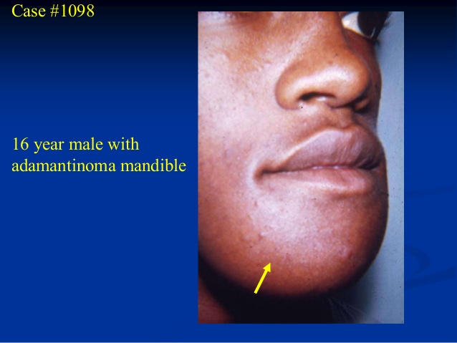

Slide 89
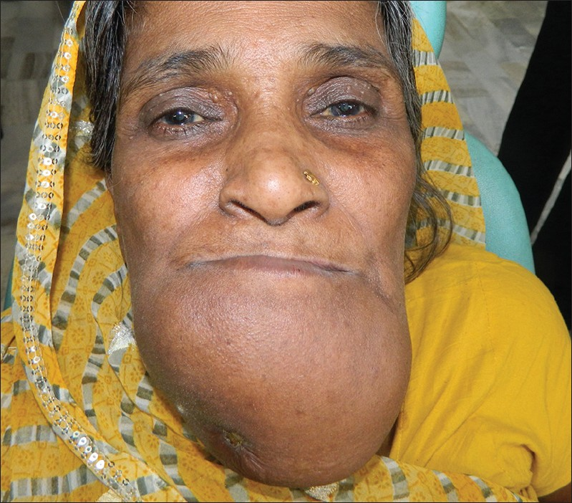

Slide 90
D/d-
1.Giant cell reparative granuloma(Jaffe tumor)
It is due to hemorrhage within the bone marrow.
This tumour affect females in the age group of 10-25yrs.
Painless enlargement of mandile.X-ray shows-radiolucent artery.
Treatment-1.Curettage
2.calcitonin- 0.5 mg daily.
( Subcutaneous injection for a year)
2.Osteoclastoma-Rare tumor
-Age-25-40 yrs
- Rapidly growing
-Both side of bone table expands.
-X-ray-Radiolucent cyst & pseudotrabeculae.

Slide 91
Treatment-
1.Simple curettage or enucleation may result in recurrence(not done)
2.Wide excision with 1cm healthy margin.
The wide excision may require segmental excision of mandible or even
hemi-mandibulectomy.

Slide 92
DENTAL CYST

Slide 93
Types
PERIAPICAL CYST (ODONTOGENIC CYST OR RADICULAR CYST)
is the most common odontogenic cyst and has various names, including radicular cyst, apical periodontal cyst, root end cyst, or dental cyst.
The death or necrosis of the pulp tissue inside the tooth, which stems from tooth decay or trauma will cause this type of cyst. The process of pulpal necrosis causes inflammation and the release of toxins at the apex or end of the root tip.
Commonly treated by endodontic therapy. In case the endodontic treatment is not effective, the extraction of the tooth is used, the place of cyst is cleaned and filled with the artificial bone material.
Traditional methods were not effective enough as cysts used to form again. To avoid this the retrograde root canal filling should be used according to the most modern treatment methods.

Slide 94
FOLLICULAR CYST OR DENTIGEROUS CYST
most commonly found in the area of the lower wisdom teeth or the permanent upper canines, develop around the crown of an unerupted tooth. The pressure exerted by an erupting tooth on the follicle may cause the dentigerous cyst. This pressure can obstruct the blood flow and create an accumulation of fluid between the enamel membrane tissue and the coronal portion of the tooth. Dentigerous cysts usually grow and expand rapidly.
The extraction of the associated tooth and the surgical excision of the cyst. Treatment is often successful, the patient is recalled to watch for recurrance.
KERATOCYSTIC ODONTOGENIC TUMORS (KCOTS)
Keratocystic Odontogenic Tumors are found mostly in the posterior area of the lower jaw or mandible and their characteristics are similar as other types of cysts. An precise diagnosis can be achieved just with biopsy and microscopic analysis, panoramic xray.
Swelling is often the only symptom a patient will experience. There are several theories surrounding the origin of the keratocyst. Some experts believe the cyst develops in the place the tooth should have. Others argue that the tumors arise from the lamina of impacted teeth.

Slide 95
DENTAL CYST
This arises from the normally erupted, chronically infected ,pulp-less caries tooth.
The caries tooth produces a low grade chronic inflammation, which stimulates epithelial debris to proliferate. Later on, this proliferated mass goes on to degeneration necrosis resulting in cyst formation in the bone.
C/F- Women-30-40 yrs.
- Common in upper jaw.
-Slow growing jaw swelling causing deformity

Slide 96
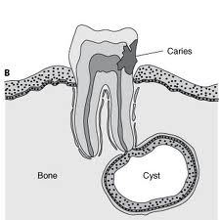

Slide 97
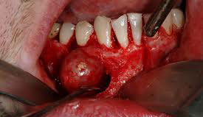

Slide 98
Diagnosis-
1.Presence of caries tooth & expansion of bone.
2.X-ray- showing large unilocular cyst in bone.
3.Aspiration of shows-cholesterol crystals.
Treatment-
1. Excision of cyst along its epithelial lining
2.After excision, the cyst wall to be curetted
followed by push in of soft tissue in cavity.
***

Slide 99
DENTIGEROUS CYST

Slide 100
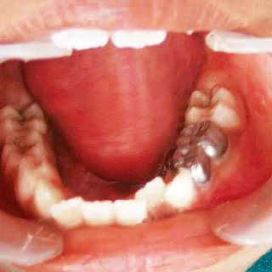

Slide 101
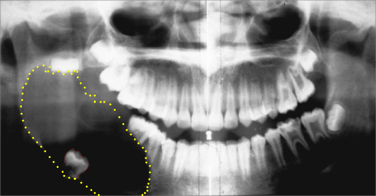
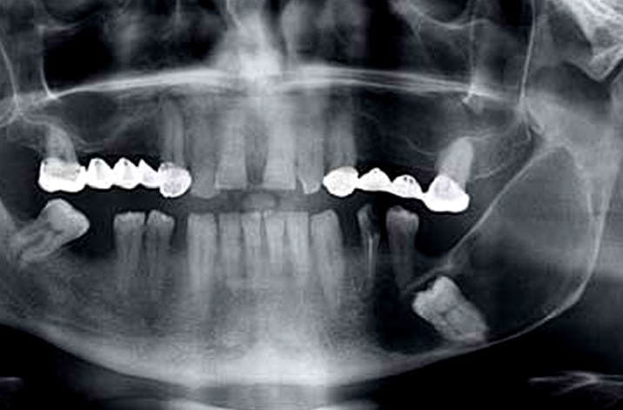

Slide 102
DENTIGEROUS CYST
Common in Lower jaw.
Common in women 30-40 yrs.
It occurs in relation to unerupted,permanent,
molar tooth,most commonly in 3rd molar tooth of lower or upper jaw.
This unerrupted tooth contantly irritates the
the cells,produces degeneration of cells resulting in
formation of dentigerous cyst.The cyst is lined by squ.
epithelium.The tooth lies within the cyst or in its wall.
It causes expansion of outer table of mandible
Clinical features-
1. Absence of molar tooth.
2. Expansion of mandible,bone gets thinned out results in egg-shell
crackling.
3.Painless swelling in the jaw which is smooth and hard.

Slide 103
D/D-Admantinoma
-Dental cyst
-Osteoclastoma
Complication-It can turn into admantinoma.
Investigation-
1.X-ray mandible-tooth in the cyst
-Soap bubble appearance due to multiple trabeculae
-Radiolucent well defined swelling.
2.OPG shows-tooth within the cyst,well defined.Soap bubble appearance due to multiple trabeculations
Treatment-A-Small cyst-Excision of cyst by intraoral route
-B-Large cyst-Managed by marsupialisation.
*************

Slide 104
ODONTOGENIC KERATOCYST (OKC)
Odontogenic keratocyst (OKC) is the cyst arising from the cell rests of dental lamina(Rest of Serres). It can occur anywhere in the jaw, but commonly seen in the posterior part of the mandible. Radio graphically, most OKCs are unilocular when presented at the peri-apex and can be mistaken for ridiculer or lateral periodontal cyst.

Slide 105
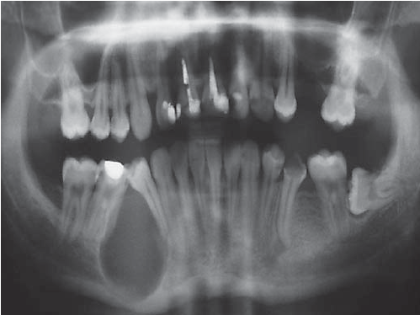

Slide 106
Clinical features-
Peak incidence during second and third decades of life. At least 50% of odontogenic keratocysts are found in posterior part and lower ramus of the mandible. Swelling is the most common presenting complaint; however, OKCs may be asymptomatic and found incidentally on dental radiographs. Rarely symptoms can arise due to infection or expansion of the bone.
Pathogenesis-
Odontogenic keratocysts originate from the odontogenic epithelium (dental lamina) in the alveolus left from tooth development stages. They are mainly thought to arise from rests of Serres.
Diagnosis-
Diagnosis is usually radiological. However, definitive diagnosis is through biopsy

Slide 107
Treatment
Depends on extent of multilocularity and cyst. Small multilocular and unilocular cysts can be treated more conservatively through enucleation and curretage.
Treatment options:
Wide (local) surgical excision to remove the whole cyst lining.
Curettage involving simple excision and scraping-out of cavity
Marsupialization can also be tried.

Slide 108
CLEFT LIP & CLEFT PALATE

Slide 109
Cleft lip and cleft palate, also known as orofacial cleft, is a group of conditions that includes cleft lip (CL), cleft palate (CP), and both together (CLP).
A cleft lip contains an opening in the upper lip that may extend into the nose. The opening may be on one side, both sides, or in the middle.
A cleft palate is when the roof of the mouth contains an opening into the nose.
These disorders can result in feeding problems, speech problems, hearing problems, and frequent ear infections. Less than half the time the condition is associated with other disorders.

Slide 110
Cleft lip and palate are the result of tissues of the face not joining properly during development. As such, they are a type of birth defect.
The cause is unknown in most cases.
Risk factors- include smoking during pregnancy, diabetes, obesity, an older mother, and certain medications(such as some used to treat seizures). Cleft lip and cleft palate can often be diagnosed during pregnancy with an ultrasound exam.

Slide 111
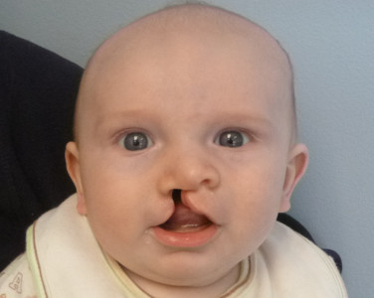

Slide 112
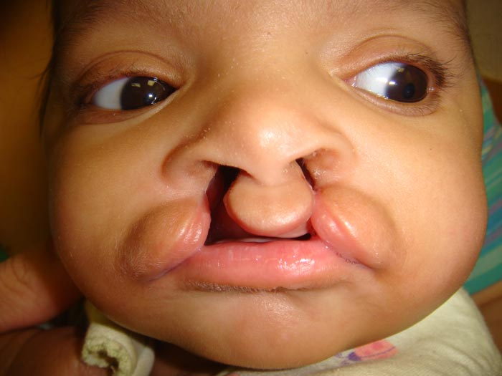

Slide 113
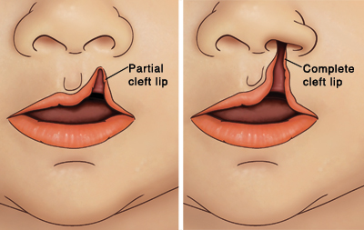

Slide 114
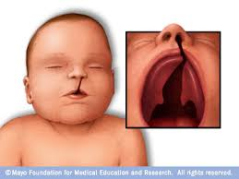

Slide 115


Slide 116
CLEFT LIP
* Cleft lip results due to non fusion of median nasal process and maxillary process.
* Types-
1.Central
2.Lateral
3.Complete or incomplete.
4. Simple or compound(with cleft in alveolus)
*C/f- 80% cases it is unilateral and
60% cases ,it is associated with C.palate.
-Nostril is widened.
-Mal-alignment of teeth is common.
*Functional effect-Difficulty in bottle feeding and speech

Slide 117


Slide 118
CLEFT PALATE
* Cleft palate result due to failure of union of two palatine wings of maxillary process.Pre-maxillary process of median nasal process,unites with palatine processes which gives a Y shaped union.
*Types-
1.Complete-Failure of fusion of pre-maxilla and two palatine processes,result in complete.
2.Incomplete-In normal,these three process start fusion from uvula to backward.
Any failure in fusion,in this route result in incomplete variety.
* Effects of cleft palate-
1.Difficulty in swallowing.
2.Unable to make sound of-B,D,K,P,T
3.Abnormal dentition(small,Crowded)
4.Nose-Oral organism infect URI.
5.Hearing-Acute and chronic otitis media may occur.

Slide 119
Management of cleft lip & cleft palate
1.Multidisciplinary approch-
-PLASTIC SURGEON
-ORTHODONTICS
-SPEECH THERAPIST
-ENT SPECIALIST
-PROSTHODONTICS
-PAEDIATRICIAN
2 Feeding advice-In cleft palate patient is unable to
suck mothers milk, so spoon feeding is done and
after that air to be released by burping.

Slide 120
Cleft lip repair-
*Rule of 10 to be followed.
Hb - 10 gm+
Age - 10 weeks
Weight- 10 lbs+
T.WBC – Less than 10,000/mm3

Slide 121
Types of cleft repair-
For unilateral C.Lip-
1.Millards rotation flap method
2.Tennison-Randall triangular flap
For bilateral C.lip-
* one stage - Veau III method is good.
-Millard’s one stage method
Basic steps-1.Markings are made according to method
2.Adrenaline-saline solu. Used for
haemostasis.
3.Full thickness is incised along with
markings.
4. Lip repair is done in 3 layers-mucosa-muscle-skin.
5. Vermilion should not have notching.

Slide 122


Slide 123
CLEFT PALATE REPAIR
Timings-Early repair causes-maxillary retardation
Late repair causes speech defect.
So, at age of 18th month repair is done.
Types-There are various types of repair present,
but the most commonly used method is
V-Y pushback palatoplasty.
Steps1.Palate is infiltrated with adrinaline+saline.
2.Two muco-periosteal flaps are raised from both
palatal sides.Then nasal flaps are mobilised.
3.Palate is closed in 3 layers.(nasal-muscle-oral layers)
4.Hooks of hamulus can be fractured to relieve tension.

Slide 124


Slide 125
REFERENCES
SRBS BOOK OF GENERAL SURGERY
A MANUAL ON CLINICAL SURGERY - S DAS
MANIPAL MANUAL OF SURGERY - K RAJGOPAL SHENOY
BAILEY AND LOVES SHORT PRACTICE OF SURGERY

